Slide 1




Good news about El Paso and a
view of the community
2017
915-252-5753 www.DebbiHester.com

Slide 2

http://visitelpaso.com/
915-252-5753 www.DebbiHester.com

Slide 3
El Paso, Texas
El Paso is the county seat of El Paso County, Texas, United States, and lies in far West Texas. As of July 1, 2016, the population estimate from the U.S Census was 683,080, making it the 19th most populous city in the United States. Its U.S. metropolitan area covers all of El Paso and Hudspeth counties, with a population of 892,695. The El Paso MSA forms part of the larger El Paso-Las Cruces CSA, with a population of 1,044,496.
El Paso stands on the Rio Grande (Río Bravo del Norte), across the border from Juárez, Chihuahua, Mexico. The two cities, along with Las Cruces, form a combined international metropolitan area, sometimes referred as the Paso del Norte or El Paso–Juárez–Las Cruces, with over 2.7 million people. THE EL PASO-JUAREZ REGION IS THE LARGEST BILINGUAL, BINATIONAL WORK FORCE IN THE WESTERN HEMISPHERE.
915-252-5753 www.DebbiHester.com

Slide 4
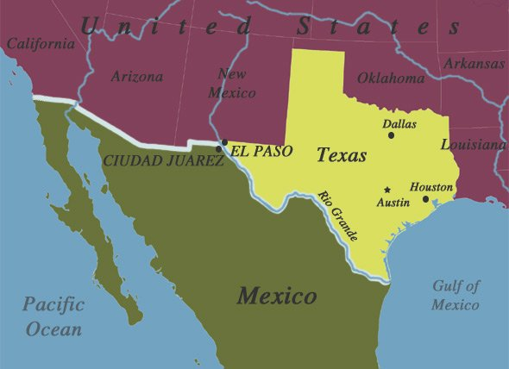
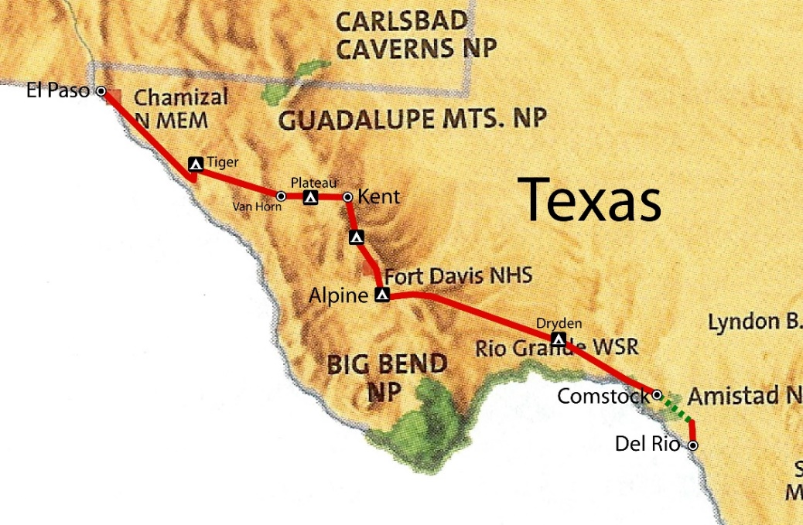
El Paso, Texas
In 1659, Fray Garcia de San Francisco, established Our Lady of Guadalupe Mission of El Paso del Norte. Around this mission, the village of El Paso del Norte grew into what is now the El Paso–Juárez region. El Paso has been ranked the safest large city in the U.S. for four consecutive years and ranked in the top three since 1997. The city is the headquarters of one Fortune 500 and three publicly traded companies, as well as home to the Medical Center of the Americas, the only medical research and care provider complex in West Texas and southern New Mexico, and the University of Texas at El Paso, the city's primary university. The city hosts the annual Sun Bowl, the second oldest bowl game in the country. In 2010, El Paso received an All-America City Award.
El Paso has a strong federal and military presence. William Beaumont Army Medical Center, Biggs Army Airfield and Fort Bliss call the city home. Fort Bliss (27,132 Active Duty) is one of the largest military complexes of the United States Army and the largest training area in the United States. Also headquartered in El Paso are the DEA domestic field division 7, El Paso Intelligence Center, Joint Task Force North, U.S. Border Patrol El Paso Sector and U.S. Border Patrol Special Operations Group (SOG).
915-252-5753 www.DebbiHester.com

Slide 5
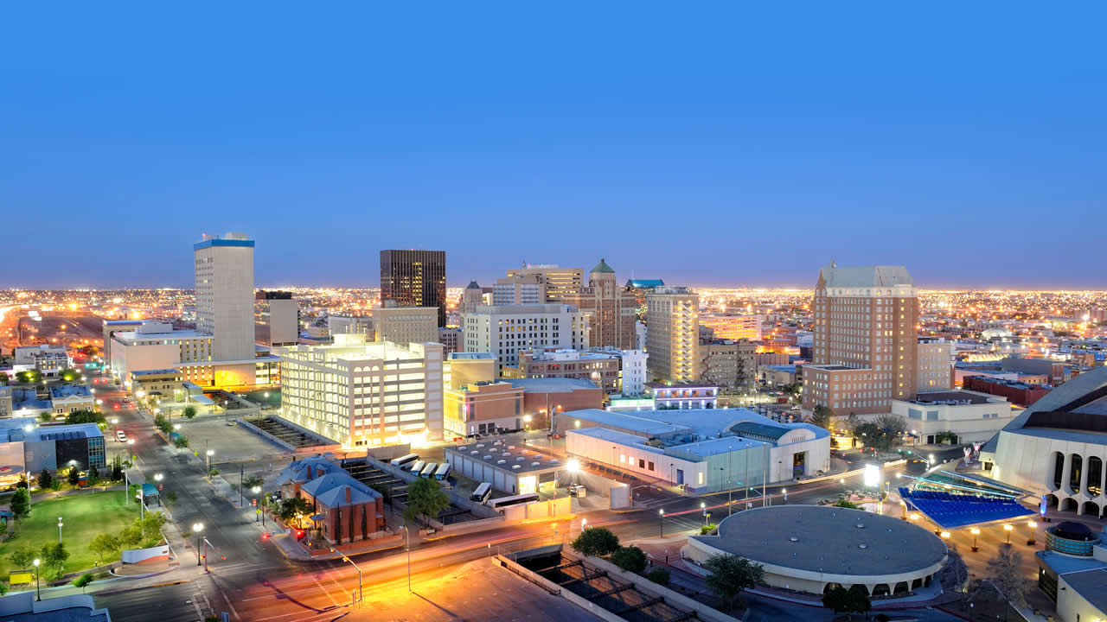
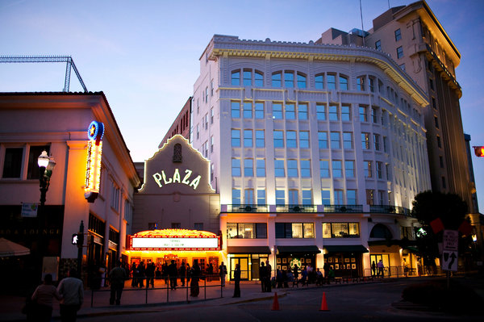
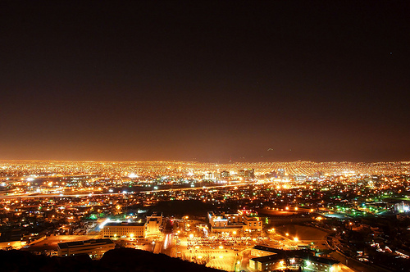
El Paso, Texas
915-252-5753 www.DebbiHester.com

Slide 6
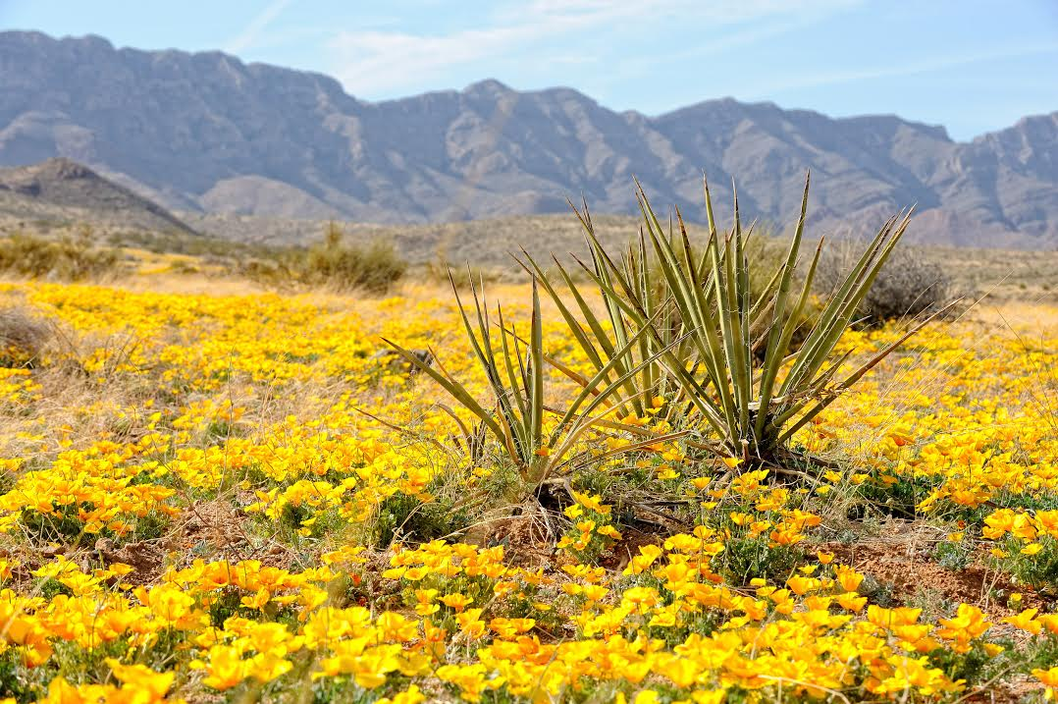


2017 Annual Poppy Festival
Spring in the Franklin Mountains means the desert landscape is blanketed by a field of
golden yellow Mexican poppies and the free 11th annual event celebrates El Paso’s
annual bloom. Enjoy live music, art vendors, educational exhibits, children's activities,
nature tours, food vendors, and more!
915-252-5753 www.DebbiHester.com

Slide 7
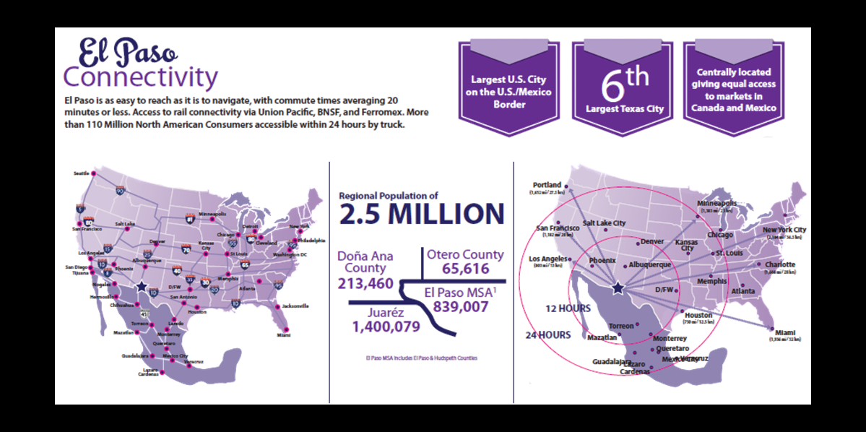

El Paso Stats
915-252-5753 www.DebbiHester.com

Slide 8
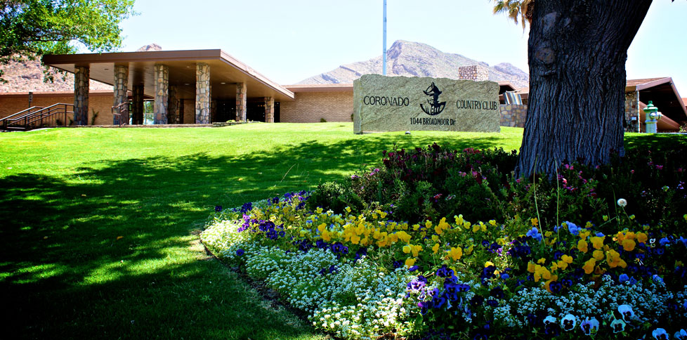
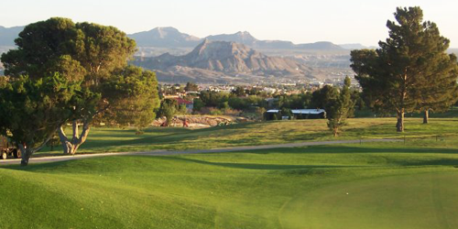
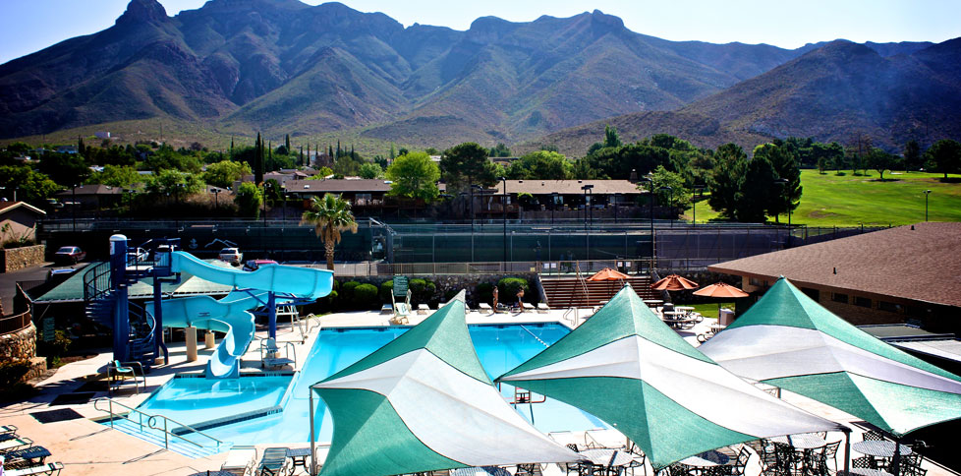
West El Paso
El Paso Coronado Country Club
915-252-5753 www.DebbiHester.com

Slide 9
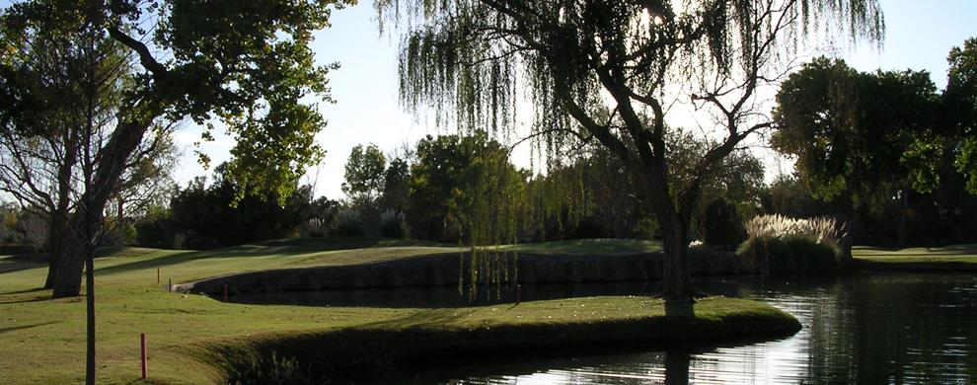
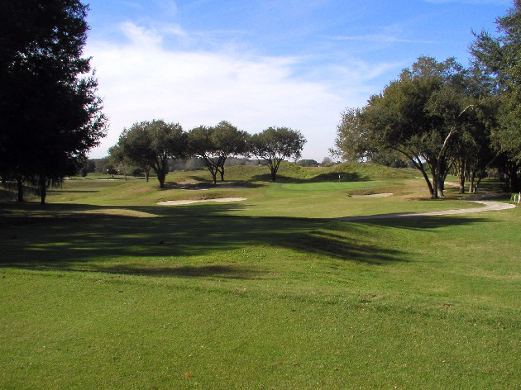
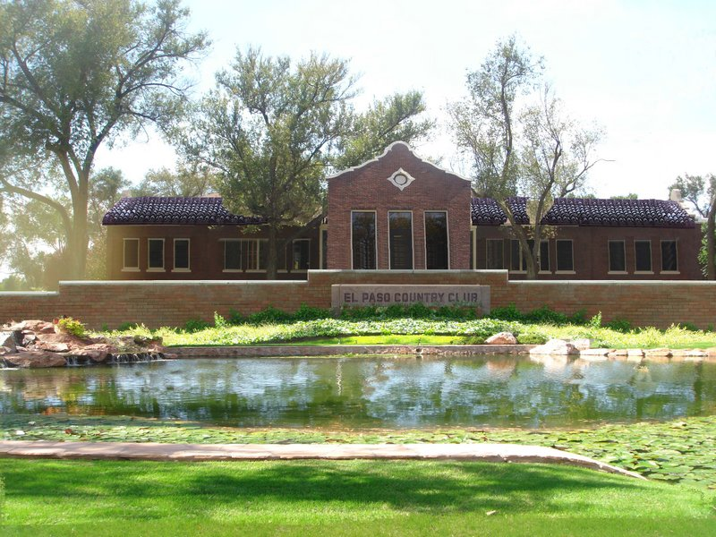
Upper Valley
El Paso Country Club
915-252-5753 www.DebbiHester.com

Slide 10
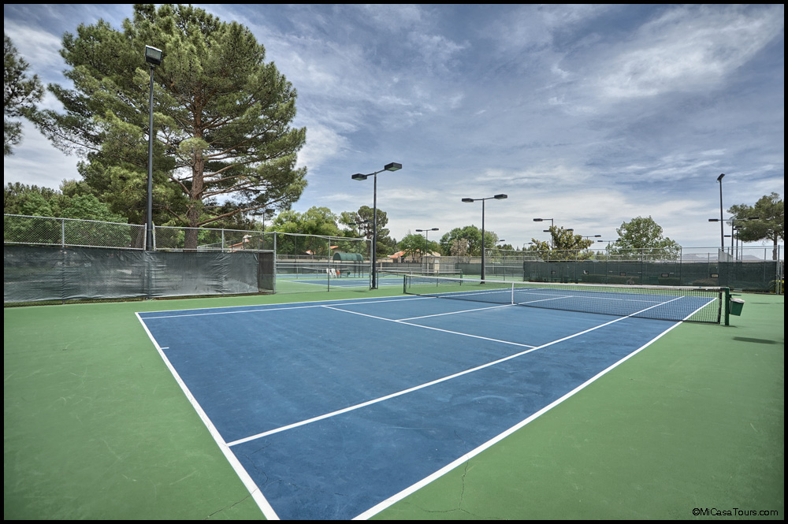
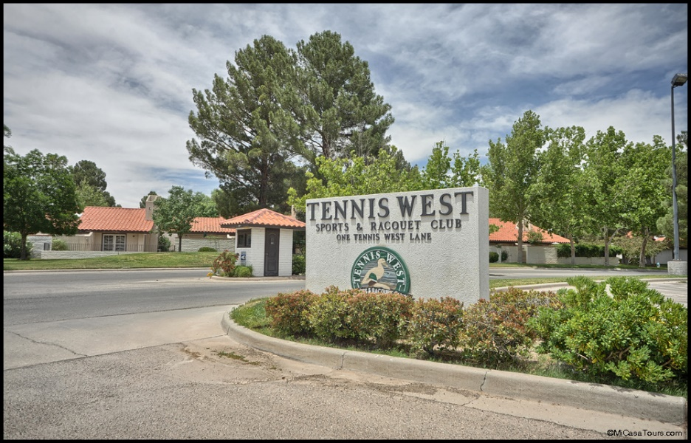
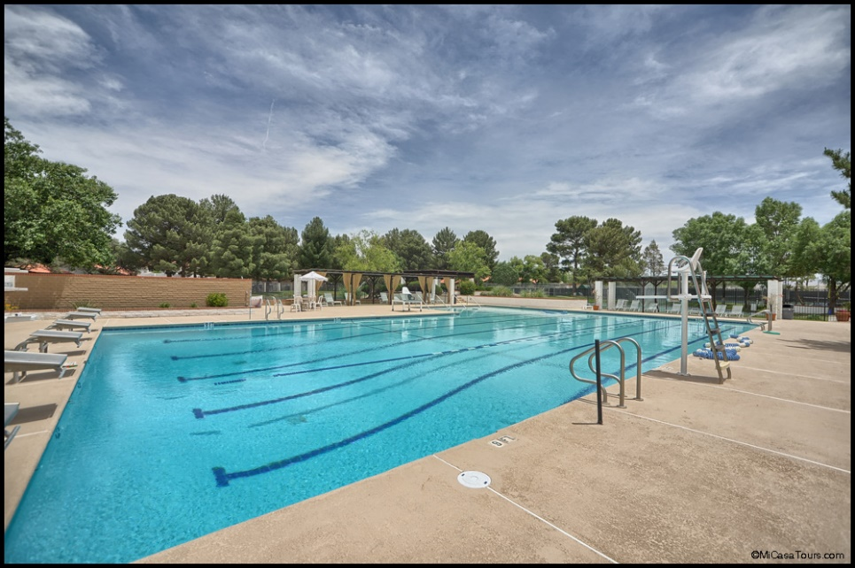
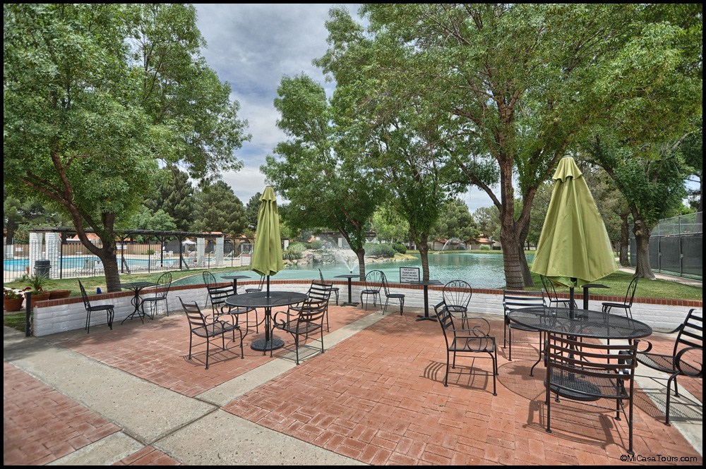
Upper Valley
El Paso Tennis West
915-252-5753 www.DebbiHester.com

Slide 11

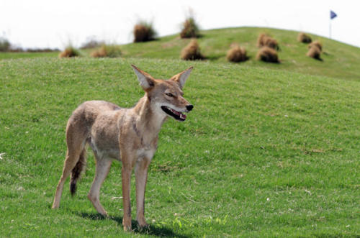
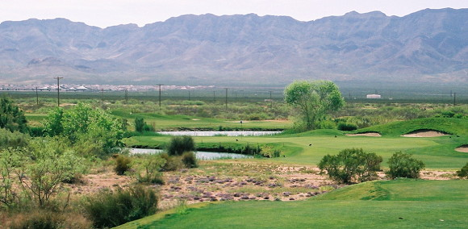
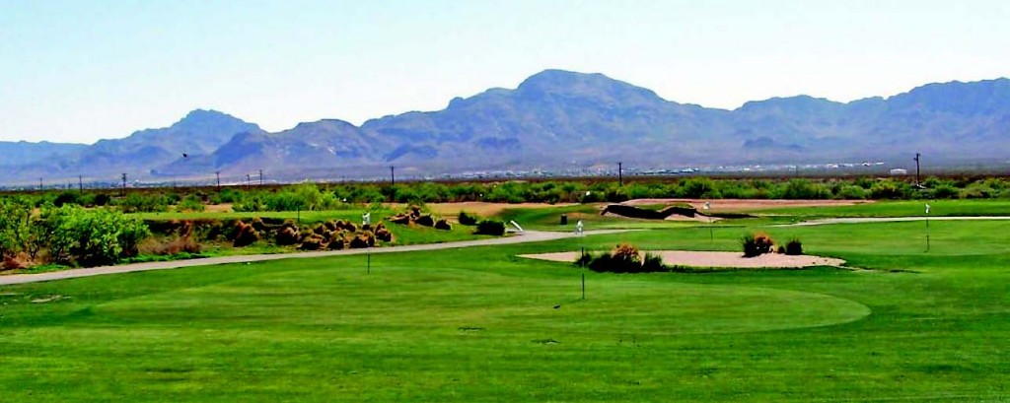
Northeast El Paso
Painted Dunes Gulf Course
915-252-5753 www.DebbiHester.com

Slide 12

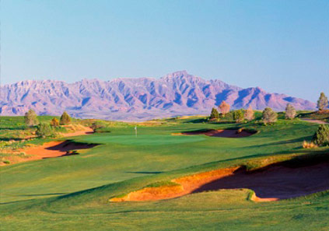

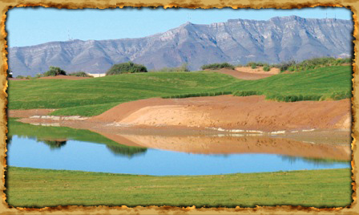
East El Paso
Butterfield Trail Gulf Course
Butterfield Trail public golf course is the #3 best course in Texas per Golf Week magazine.
915-252-5753 www.DebbiHester.com

Slide 13
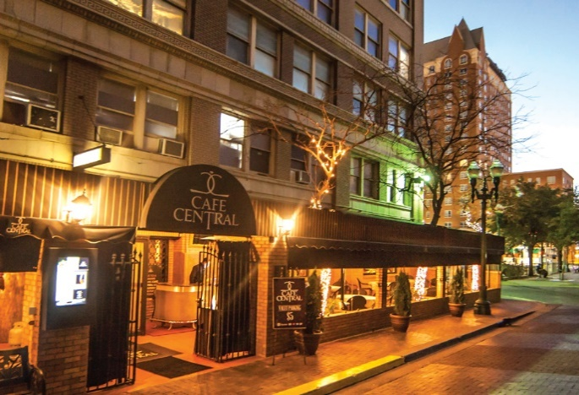
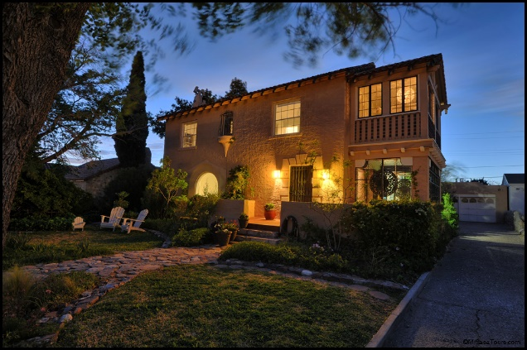
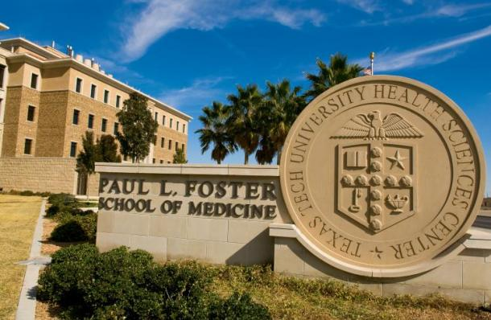
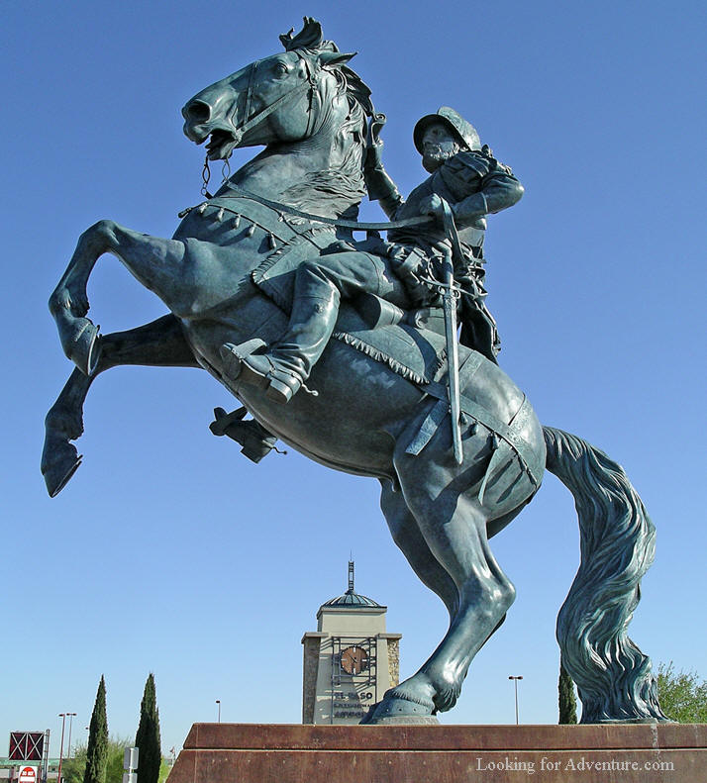
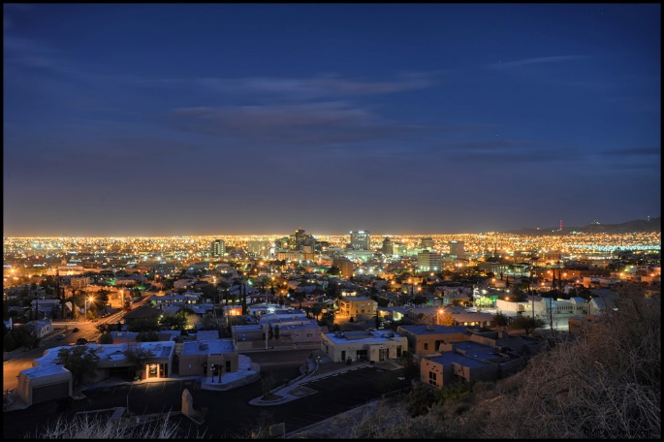
Geographic diversity
Central El Paso
Downtown
Rim Road
Kern
TTUHSC
El Paso Airport
915-252-5753 www.DebbiHester.com

Slide 14
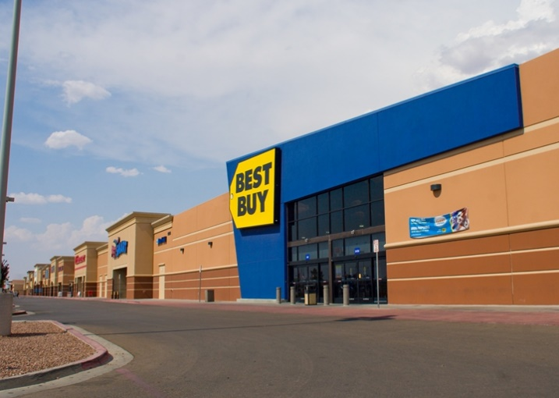
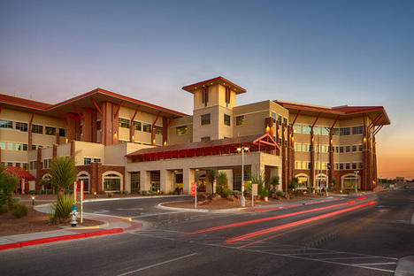
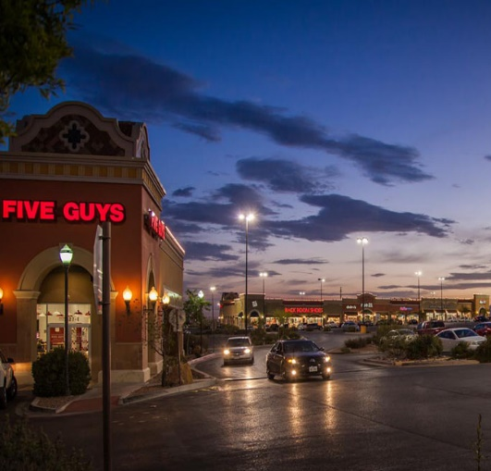
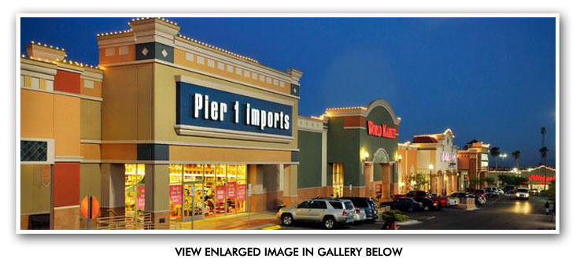
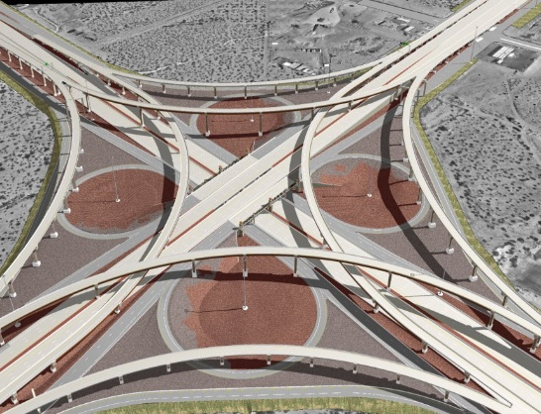

East El Paso has 80% of the Population!
915-252-5753 www.DebbiHester.com

Slide 15
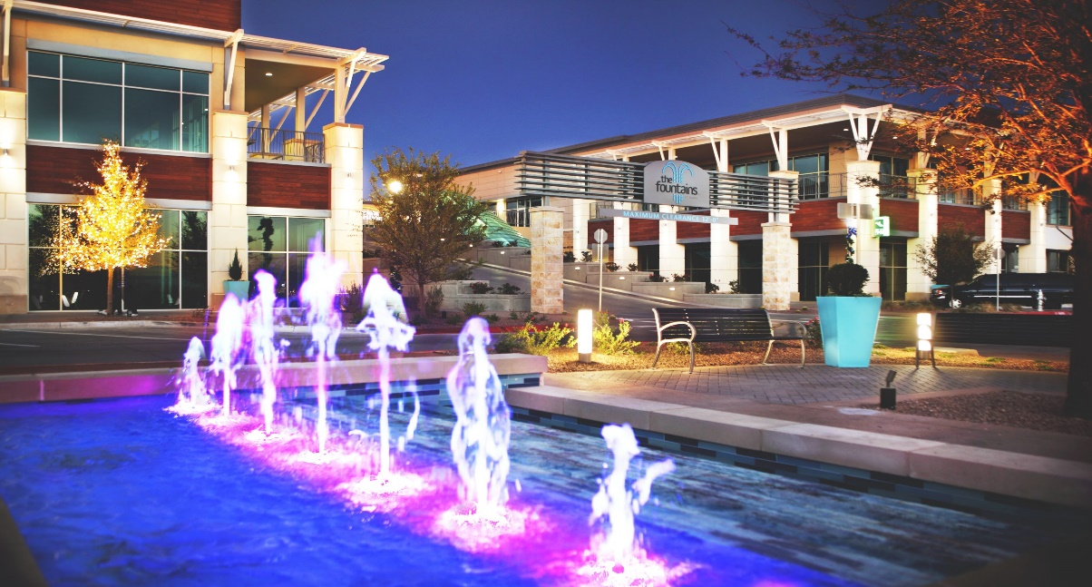
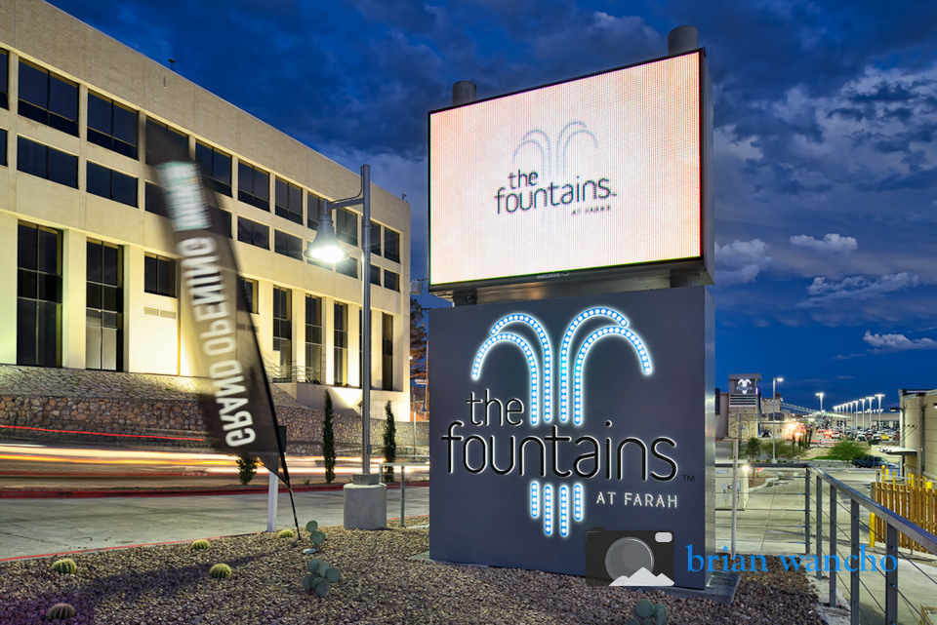
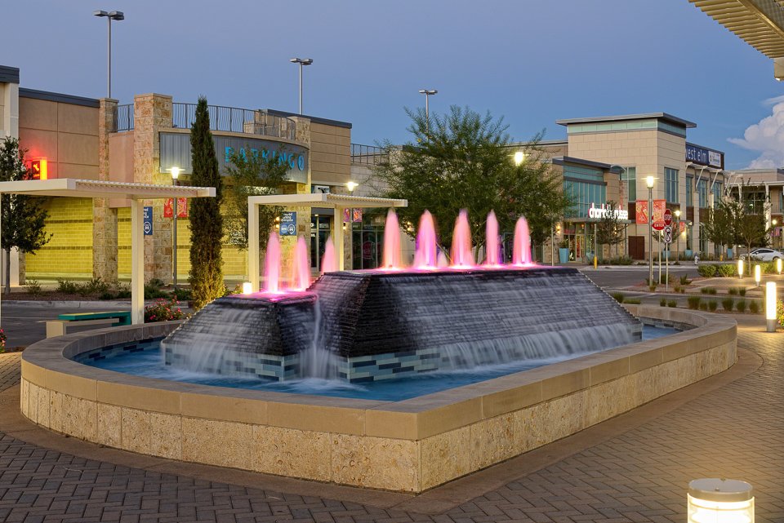
Fountains at Farah
915-252-5753 www.DebbiHester.com

Slide 16
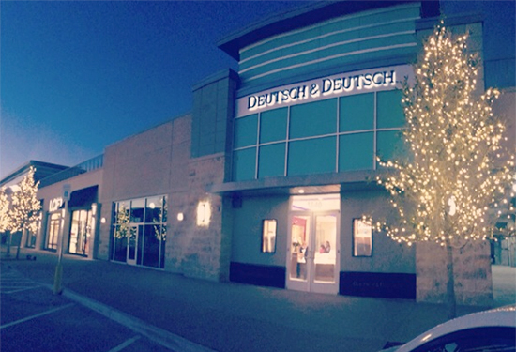
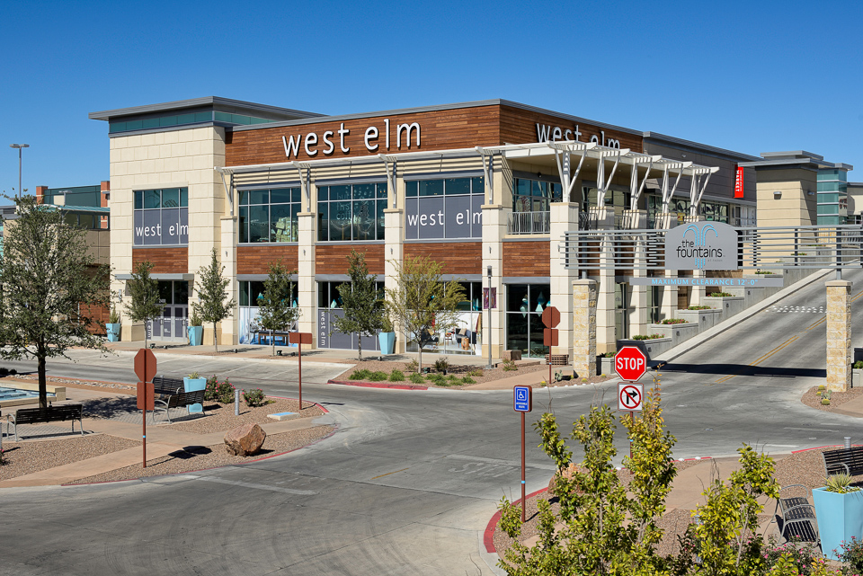
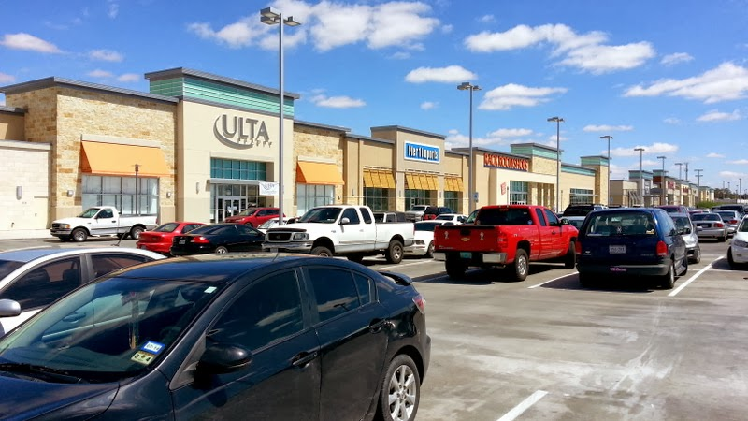
Shopping at the Fountains at Farah
915-252-5753 www.DebbiHester.com

Slide 17
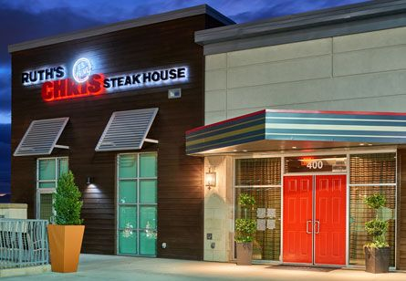
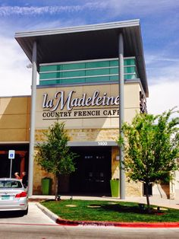
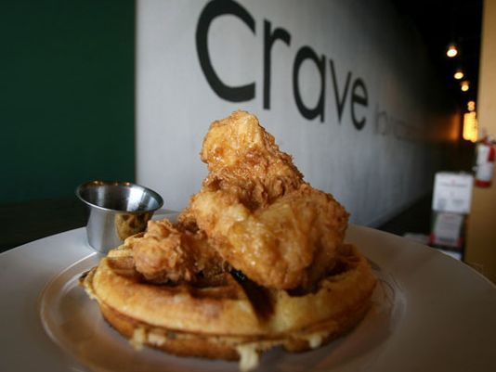
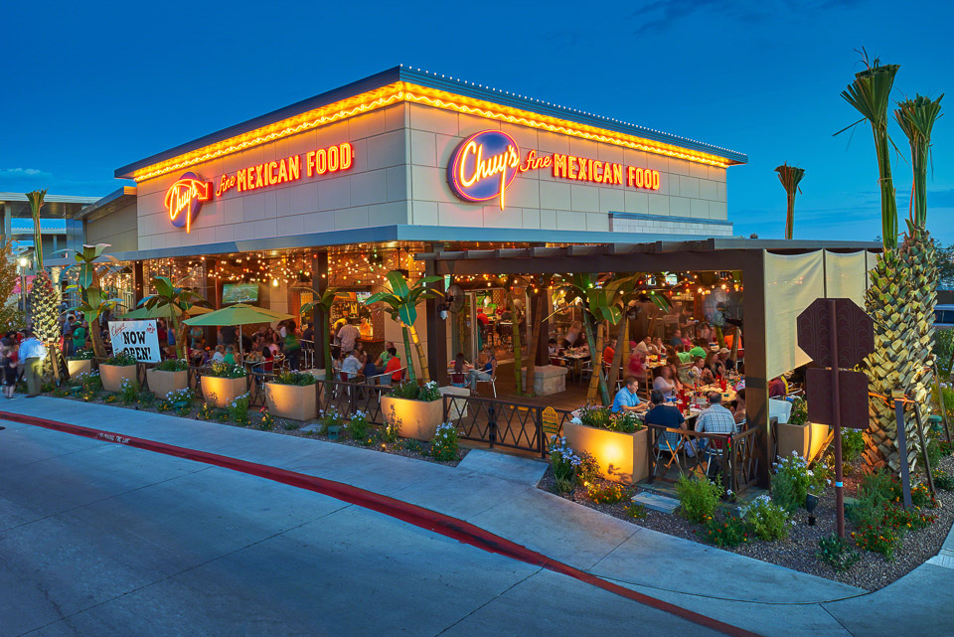
Dining at the Fountains at Farah
915-252-5753 www.DebbiHester.com

Slide 18
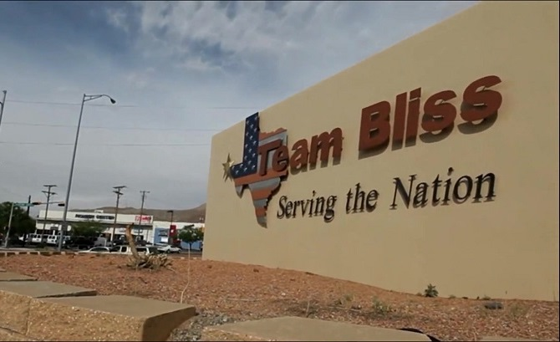
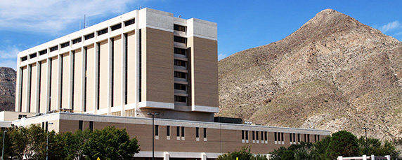
Fort Bliss: Major contributor in El Paso, TX
William Beaumont Army Medical Center
The city also has a large military presence with Fort Bliss, William Beaumont Army Medical Center and Biggs Army Airfield. The military installation of Fort Bliss is a major contributor to El Paso's economy. Fort Bliss began as a Calvary post in 1848. Today, Fort Bliss is the site of the United States Army's Air Defense Center and produces approximately $80 million in products and services annually, with about $60 million of those products and services purchased locally. Fort Bliss' total economic impact on the area has been estimated at more than $1 billion, with 12,000 soldiers currently stationed at the Fort.
http://www.city-data.com/us-cities/The-South/El-Paso-Economy.html#ixzz4iapN0vqx
915-252-5753 www.DebbiHester.com

Slide 19
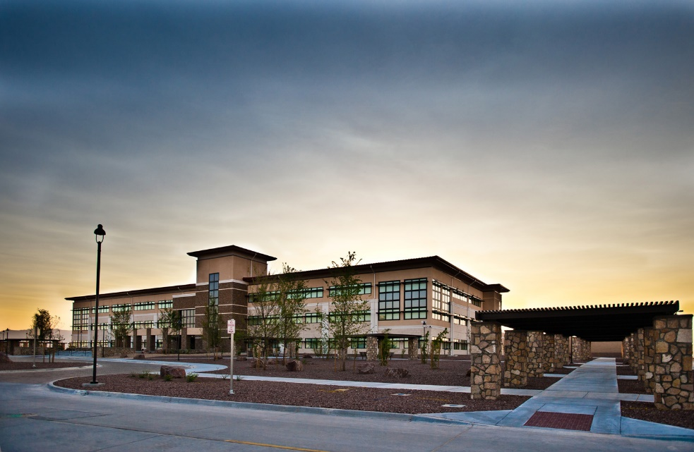
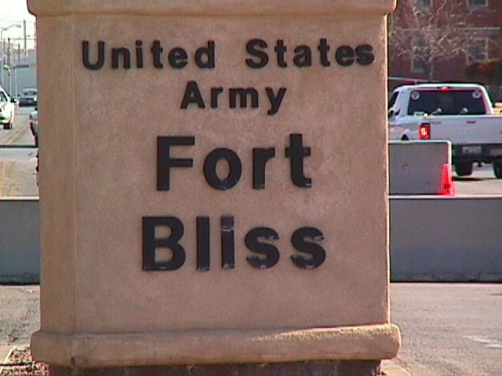
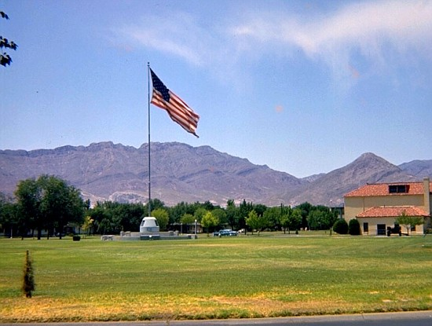
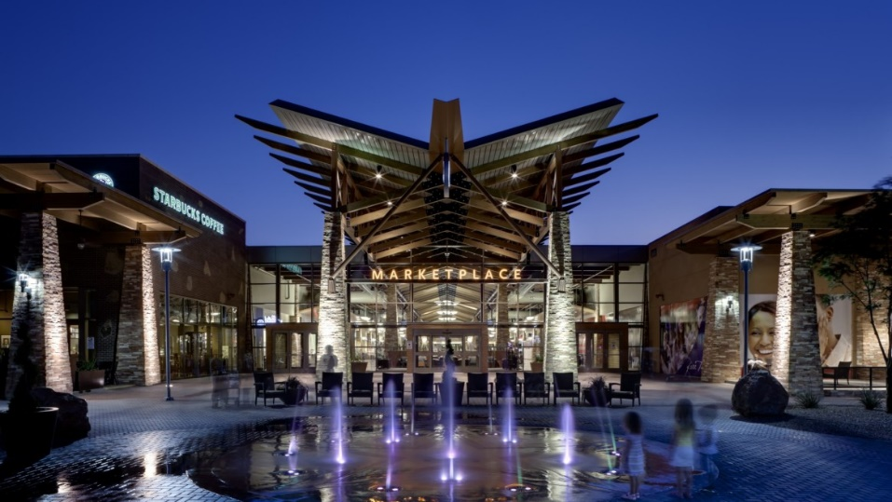
Fort Bliss
Freedom Crossing​
915-252-5753 www.DebbiHester.com

Slide 20
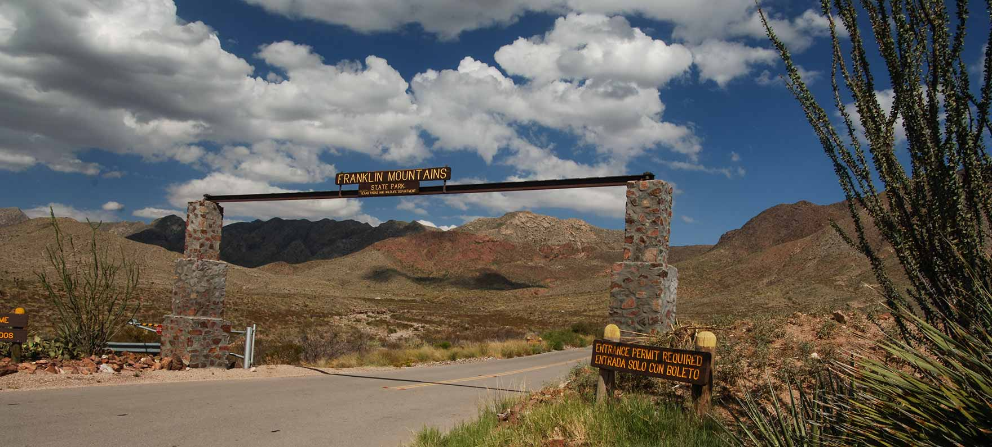
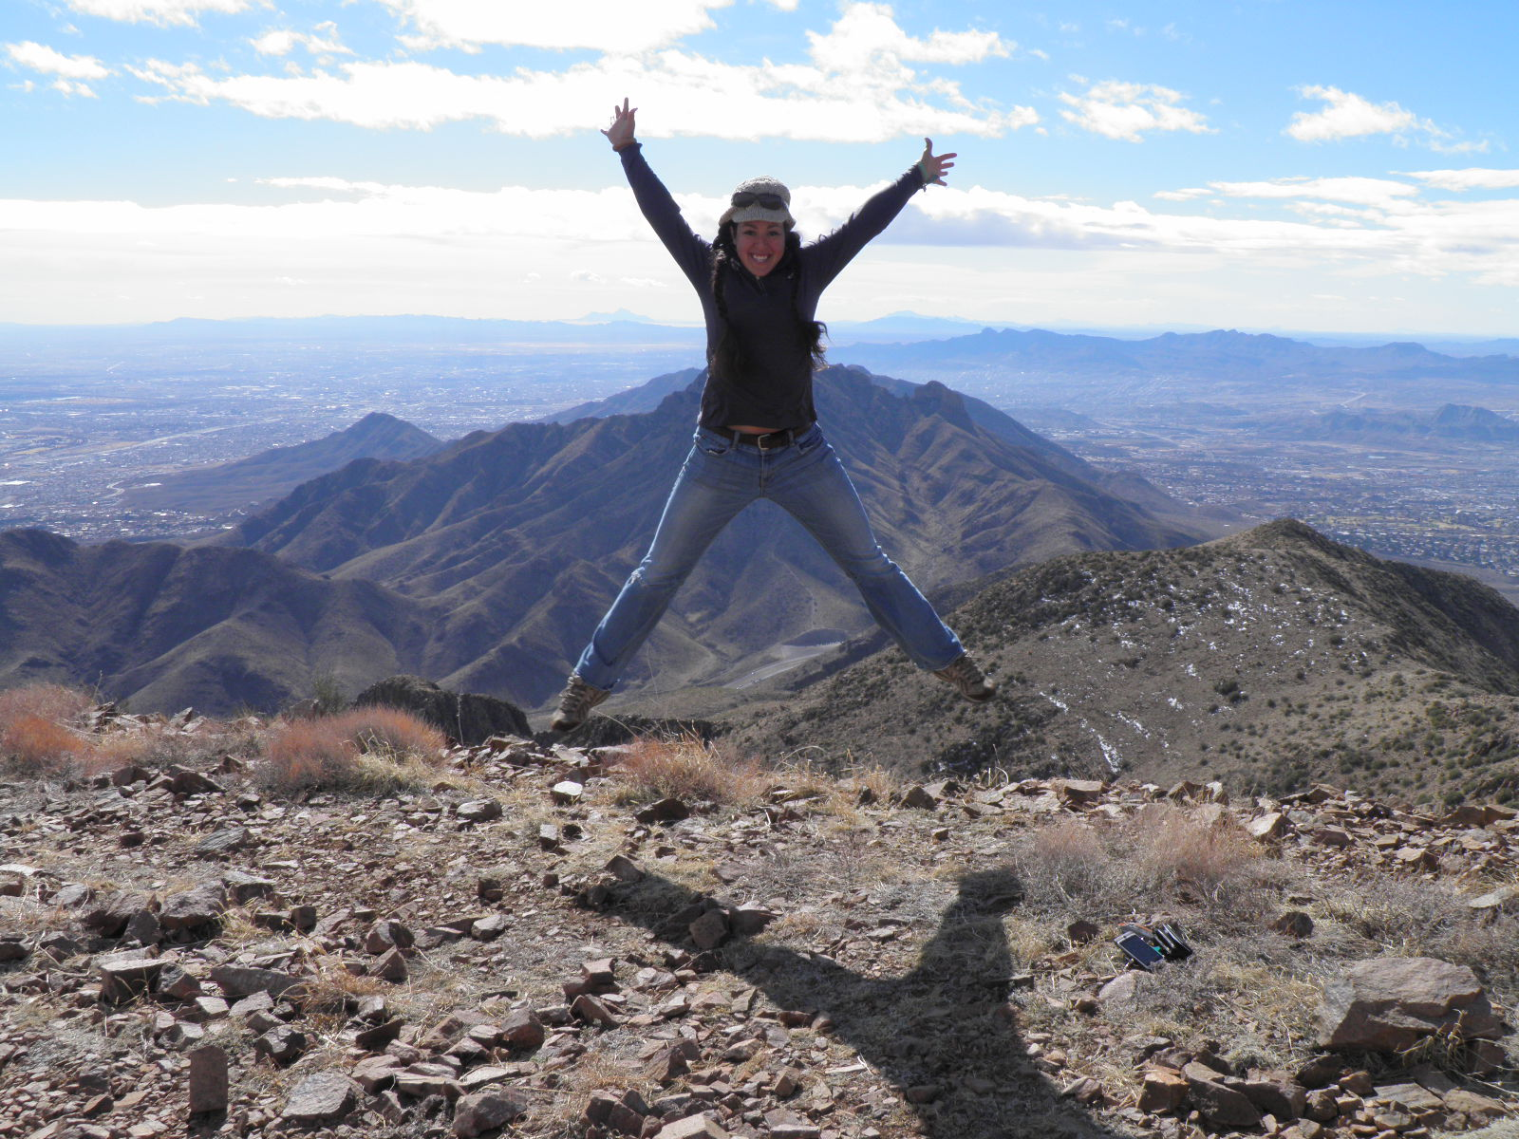

Trans-Mountain Road
Franklin Mountains State Park
http://tpwd.texas.gov/state-parks/franklin-mountains
915-252-5753 www.DebbiHester.com

Slide 21



El Paso has the largest urban state park, 24,049 acres, (Mt. Franklin State Park) in the US. Work is underway that will ultimately have more than 100 miles of trails plus rock climbing.
915-252-5753 www.DebbiHester.com

Slide 22




Hueco Tanks State Park & Historic Site http://tpwd.texas.gov/state-parks/hueco-tanks
915-252-5753 www.DebbiHester.com

Slide 23




Central El Paso
El Paso Zoo
915-252-5753 www.DebbiHester.com

Slide 24



Parks and Free Splash Pads
915-252-5753 www.DebbiHester.com

Slide 25



Central El Paso/Ascarate Park
Annual Sun City Music Festival
915-252-5753 www.DebbiHester.com

Slide 26




Downtown El Paso
El Paso Museum of Art
915-252-5753 www.DebbiHester.com

Slide 27




Downtown El Paso
El Paso History Museum
El Paso Museum of History has the only DIGITAL WALL of history in the entire United States. Thousands of visitors have seen it since opening 2/2015.
915-252-5753 www.DebbiHester.com

Slide 28



Downtown El Paso
Southwest University Park
The 2014 debut season for the El Paso Chihuahuas AAA baseball team was a huge success with attendance in El Paso of 540,000 happy fans. El Paso hosted the 2015 Triple A Championship Game with Pacific Coast and International League champions 9/2015.
915-252-5753 www.DebbiHester.com

Slide 29



Downtown El Paso
Southwest University Park
915-252-5753 www.DebbiHester.com

Slide 30



Downtown El Paso
Chalk the Block
915-252-5753 www.DebbiHester.com

Slide 31



Downtown El Paso
Annual Downtown Street Fest​
915-252-5753 www.DebbiHester.com

Slide 32



Downtown El Paso
Annual Neon Desert Music Festival ​
915-252-5753 www.DebbiHester.com

Slide 33



Downtown El Paso
Annual Plaza Classic Film Festival
Debbi Hester & Perry Hester Proud Sponsors​
The Plaza Classic Film Festival is the largest one in the world and held in early August each year with over 80 films and many especially for children. Plazaclassic.com
915-252-5753 www.DebbiHester.com

Slide 34




Downtown El Paso
Annual Plaza Classic Film Festival
​
http://plazaclassic.com/
915-252-5753 www.DebbiHester.com

Slide 35



Northeast El Paso
McKelligon Canyon
​http://elpasolive.com/coolcanyonnights
915-252-5753 www.DebbiHester.com

Slide 36




Northeast El Paso
McKelligon Canyon ​
915-252-5753 www.DebbiHester.com

Slide 37



Northeast El Paso
McKelligon Canyon ​
915-252-5753 www.DebbiHester.com

Slide 38



Downtown El Paso
Convention Center​
915-252-5753 www.DebbiHester.com

Slide 39


UTEP
Basketball and Football Games​
915-252-5753 www.DebbiHester.com

Slide 40

Downtown El Paso
El Paso Downtown Plaza​
915-252-5753 www.DebbiHester.com

Slide 41



Views of El Paso, TX
Revitalized Mills Building
New Artist Lofts
New Westin Hotel/Entertainment District​
915-252-5753 www.DebbiHester.com

Slide 42




Upper Valley
Zin Valley Vineyards​
915-252-5753 www.DebbiHester.com

Slide 43



Central El Paso
Scenic Drive​
Walk, run, bike or even skate on Scenic Drive every Sunday in El Paso.
The one and a half-mile-long road is closed to all motorized traffic, and open to
Anyone looking to take an early walk with the family or pet, for free. Dogs are
also welcome, as long as they are leashed and have all vaccinations. Both ends
of the road are closed by a large gate that will prevent cars from going inside.
To participate, park at the Kentucky and Richmond area and walk up or by the
Rim Road entrance. The hours are 6 a.m. to 11 a.m. April 2 through
September 1, and 7 a.m. to 12 p.m. beginning October 1.
915-252-5753 www.DebbiHester.com

Slide 44



Central El Paso
Municipal Rose Garden
915-252-5753 www.DebbiHester.com

Slide 45




Ruidoso and Ski Apache
New Mexico
915-252-5753 www.DebbiHester.com

Slide 46




Guadalupe Mountains
Texas
915-252-5753 www.DebbiHester.com

Slide 47




Carlsbad Caverns
New Mexico
915-252-5753 www.DebbiHester.com

Slide 48

Chihuahuan Desert
Largest Desert In North America
Covering more than 200,000 square miles -- Most of it lies south of the international border. In the U.S. it extends into parts of New Mexico, Texas and sections of southeastern Arizona. Its minimum elevation is above 1,000 feet, but the vast majority of this desert lies at elevations between 3,500 and 5,000 feet.
Winter temperatures are cool, and summer temperatures are extremely hot. Most of the area receives less than 10 inches of rainfall yearly .While some winter rain falls, most precipitation occurs during the summer months. http://www.desertusa.com/chihuahuan-desert.html#ixzz4iaUTH6T4
915-252-5753 www.DebbiHester.com

Slide 49




Northwest El Paso: 79912 schools top rated schools in El Paso.
https://www.episd.org/
Lundy
Tippin
Polk
Western Hills
Hornedo MS
Coronado HS-IB
curriculum
Franklin HS
915-252-5753 www.DebbiHester.com

Slide 50




University of Texas at El Paso
915-252-5753 www.DebbiHester.com

Slide 51




University of Texas at El Paso http://www.utep.edu/
915-252-5753 www.DebbiHester.com

Slide 52

Great Places to Eat
West Side
Ripe Specials
Prime Rib Monday
Served 5 pm until we are out! Dine in only.
Accompanied with asparagus and green chile mashed potatoes 15
Extended Happy Hour until 8 pm (drinks only)
El Happy Hour
Monday thru Friday 3 to 6 pm
$1 off 16 oz draft beer
$2 off 23 oz draft beer
1/2 off glasses of wine
$3 off appetizers
Tuesday Burger Night
5-9 pm
Choice of Triple B, Big Kahuna, Green Chile & Ham, Italian Caprese, Bordeaux, Black Bean Veggie Served with fries, chips, or simple salad 8
Texas can craft beer 3
Saturday Live Music
Patio Music
915-252-5753 www.DebbiHester.com

Slide 53

Basico Bistro & Café
D A I L Y L U N C H S P E C I A L S
Monday- Friday 11:30 to 2:00 pm.
M O N D A Y
BURGER OF THE DAY.
FRENCH CROISSANT.
CAESAR SALAD WITH
CHICKEN.
T U E S D A Y
CEVICHE TOSTADAS.
TURKEY CAPRESE SANDWICH.
SUNDRIED TOMATO PENNE
WITH SHRIMP.
W E D N E S D A Y
STRAWBERRY WALNUT SALAD
WITH CHICKEN.
N.Y. STEAK WITH VEGGIES.
SMALL MARGHERITA PIZZA.
T H U R S D A Y
SMALL PEPPERONI SALAMI
PIZZA.
CHICKEN WINGS.
BASICOBB SALAD.
F R I D A Y
AHI TUNA TOSTADAS.
FISH & CHIPS.
GOAT CHEESE AND CRANBERRIES SALAD WITH CHICKEN.
S W E E T E N D I N G . $ 3
SOUP OF THE DAY AND HOUSE SALAD $8
DAILY SPECIAL. House salad or soup of the day + meal.$10.
C H O O S E Y O U R M E A L
GET A HOMEMADE SCONE OR A SCOOP OF VANILLA ICE CREAM
& A CUP OF HOUSE COFFEE.

Slide 54

Thyme Matters
Margaritas half price every Wednesday all day
Happy Hour 4 PM to 6:30 PM
915-252-5753 www.DebbiHester.com

Slide 55



Carnitas Queretaro
915-252-5753 www.DebbiHester.com

Slide 56
El Paso News
El Paso was designated a 2014 Tree City by the Arbor Day Foundation for spending $$$ on trees for a more beautiful city. Participating communities have demonstrated a commitment to caring for and managing their public trees.
More than 300 trees have recently been added to Downtown El Paso through projects including the reconstruction of San Jacinto Plaza, upgrades to Santa Fe Street, and the construction of the Pedestrian Pathway.
The reconstruction of Montwood Drive in East El Paso added 120 trees to neighborhoods.
The reconstruction of Country Club Road in the Upper Valley is adding 460 trees.
The Vocational Pond project added nearly 200 trees in and around a once-empty retention pond near Riverside High School.
915-252-5753 www.DebbiHester.com

Slide 57

El Paso News
Entertainment and cool events at
http://www.epscene.com/featurestory.html
El Paso is rated one of the safest cities in
the USA
The Huffington Post included El Paso in the 8 always perfect weather cities in the world:
http://www.huffingtonpost.com/orbitzcom/8-places-with-always-perfect-weather_b_6575234.html
You probably know it because of the salsa, and how do you think they get such high quality salsa vegetables? Sunshine! El Paso has dry heat and just enough rainfall to keep the plants happy. Much like San Diego, El Paso is an outdoor playground. You can climb rocks in Hueco Tanks State Park or cycle through Franklin Mountains State Park—the largest urban state park.
The list includes El Paso, Oahu, Nice, San Diego, Malaga, the Canary Islands, Sydney, Loja Ecuador. welpasorelocate.com and http://www.epscene.com/featurestory.html
So El Paso (Special El Paso theme Products)
https://www.facebook.com/soelpaso
915-252-5753 www.DebbiHester.com

Slide 58
El Paso News
26 Things you need to know about El Paso before you move there!
http://www.movoto.com/el-paso-tx/moving-to-el-paso/
37 Things you probably didn’t know about El Paso!
http://www.movoto.com/el-paso-tx/el-paso-facts/
Movoto Blog lists El Paso as the third best city to raise a family in the US and among the best cities for home buyers.
http://www.familydaysout.com/kids-things-to-do-usa/el-paso/tx/
Movoto Blog has El Paso ranked as one of the Best Cities for pet lovers.
https://www.google.com/maps/d/viewer?msa=0&mid=zMZ9uHKP8o1Q.kX04l2yhDTxA
915-252-5753 www.DebbiHester.com

Slide 59
FAQ’s from Debbi Hester
Best auto mechanic shop C. J. Automotive 915 581 9310
Best Carpet Cleaner Fiber Care 915-820-2656
Best Electrician Caldwell Electric 915-593-4966
Best Sprinkler Company St John Sprinkler 915-519-1098
Best Tennis Shop Coronado Tennis 915-584-1900
Best Tennis Pros Ross walker 915-581-5471
Best West side Gym Pure Barre 915-875-0031
Best Gym Planet Fitness 915-833-7867
Best Gym Mind and Body Studio 915-585-6362
Best Painter Ken Walker 915-443-2589
915-252-5753 www.DebbiHester.com

Slide 60
FAQ’s from Debbi Hester
Affordable Contractor Aria Construction 915-727-3267
Best Landscaping 4 Brothers (915) 491-6571
Best Cleaning Service Carlos Villalobos 915-472-3371
Best Dentist John Reynolds 915-779-5781
Best Bakery/Pastry Nothing Bundt Cakes 915-260-8206
Best Pastries Pastry chef 915-585-9080
Wine Selections Specs 915-585-1008
Best Outlet Store Charlottes Furniture Attn. Cecila 915-581-1111
Best Roofer Alfredo Rodriguez (915) 240-9599
915-252-5753 www.DebbiHester.com

Slide 61




Thank you
El Paso Pro Musica
Junior League of El Paso
El Paso Electric
Ripe Eatery
915-252-5753 www.DebbiHester.com

